Slide 1


Data Analysis of
Social Buzz

Slide 2


Today's agenda
Project recap
Problem
The Analytics team
Process
Insights
Summary

Slide 3

Social Buzz, a rapidly growing technology unicorn, must swiftly adapt to its global expansion. Accenture has initiated a 3-month Proof of Concept (POC) that focuses on the following tasks:
Conducting an audit of Social Buzz's big data practices
Providing recommendations for a successful IPO
Analyzing to identify Social Buzz's top 5 most popular content categories
Project Recap

Slide 4

Problem
With over 100,000 posts per day and a staggering 36,500,000 pieces of content per year.
how can Social Buzz capitalize on such a vast amount of content?
The focus is on analyzing to identify Social Buzz’s top 5 most popular content categories.

Slide 5



Andrew Fleming
Chief technical Architect
The Analytics team
Marcus Rompton
Senior Principle
Ankan Sadhu
Data Analyst

Slide 6
Process
1
Data Understanding
2
Data Cleaning
3
Data Modeling
4
Data Analysis
5
Uncover Insights

Slide 7

Insights
16
1738
MAY
REACTION TO
“ANIMAL” POST
MONTH WITH
MOST POSTS
UNIQUE CATEGORIES

Slide 8
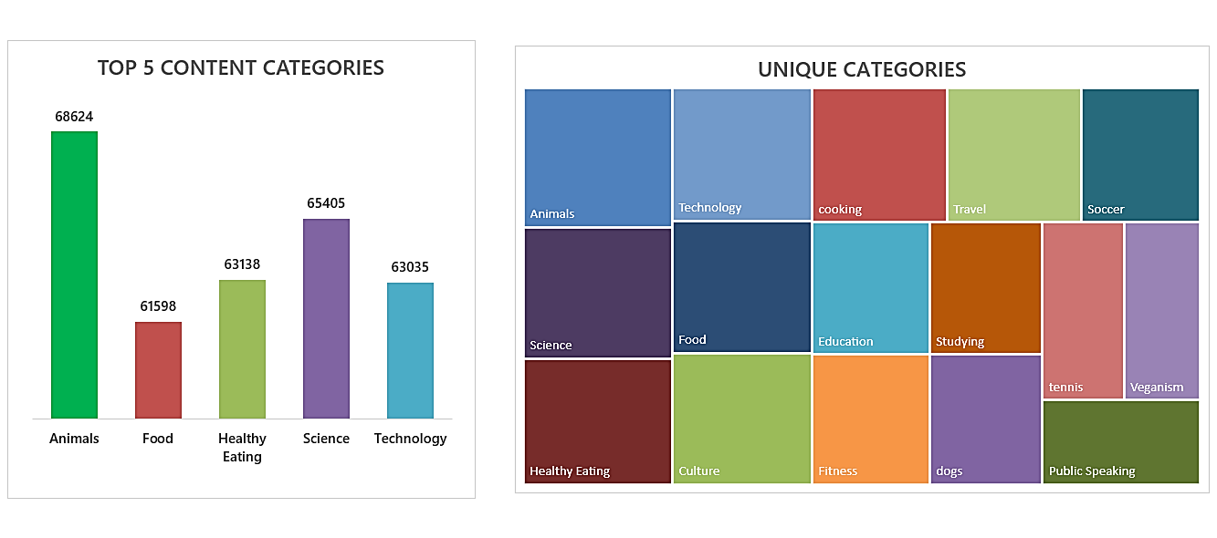

Slide 9
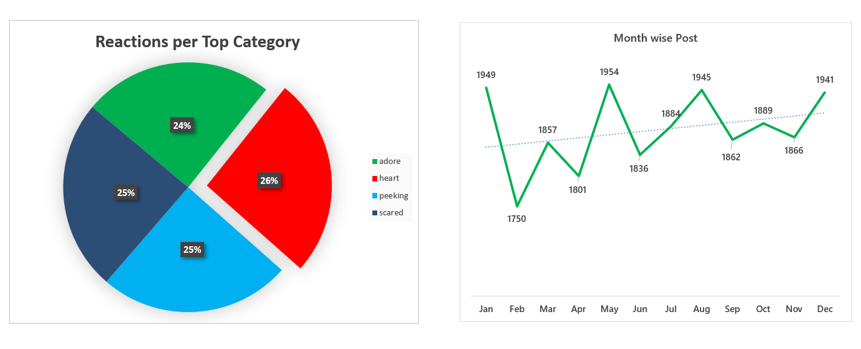

Slide 10

Unique Categories:
The dataset features diverse topics, including Animals, Technology, Food, Healthy Eating, Science, Cooking, Travel, Soccer, Education, and more niche areas like Veganism and Public Speaking.
Top 5 Content Categories:
Animals dominated with the highest number of posts (68,624), followed by Science (65,405), Healthy Eating (63,138), Technology (63,035), and Food (61,598).
Reactions per Top Category:
Reactions are evenly distributed across four categories:
Heart: 26%
Peeking: 25%
Scared: 25%
Adore: 24%
Month-Wise Post Trend:
Posts peaked in May with 1954 posts.
The lowest activity was in February with 1750 posts.
Overall, there is a gradual upward trend in monthly posts throughout the year.
Summary

Slide 11
Thank you!
ANY QUESTIONS?

